Slide 1

BUSINESS PERFORMANCE ANALYSIS
BUSINESS REQUIREMENTS
To conduct a comprehensive analysis of Blinkit’s sales performance, customer satisfaction, and inventory distribution to identify key insights and opportunities for optimization using various KPI’s and visualization in Power BI.
KPI’S
Total Sales: The overall revenue from items sold.
Number of Items sold: The total count of different items sold.
Average Sales: The average revenue per sale.
Average Rating: The average customer rating for items sold.

Slide 2
BUSINESS PERFORMANCE ANALYSIS
GRANULAR REQUIREMENTS
Total Sales by Fat Content: Analyse the impact of fat content on total sales.
Total Sales by Item Type: Analyse performance of various item types in terms of total sales.
Fat Content by Outlet for Total Sales: Total sales across different outlets segmented by fat content.
Total Sales by Outlet Establishment: Assess how age or type of outlet affects total sales.
Percentage Sales by Outlet Size: Analyse correlation b/w outlet size and sales.
Sales by Outlet Location: Assess geographic distribution of Sales across outlets.
All metrics by Outlet Type: View of all metrics by outlet type.

Slide 3

PROJECT STEPS
Requirement gathering
Data walkthrough
Data connection
Data cleaning
Data modelling
Data processing
Dax calculations
Dashboard
Charts and formatting
Reporting
Insights generation

Slide 4

Requirements Gathering
Identified the business problem: Blinkit wants insights into sales performance, customer satisfaction, and inventory distribution.
Defined KPIs: Total Sales, Items Sold, Average Sales, and Average Rating.
Set granular goals: Break down metrics by fat content, item type, outlet characteristics (size, type, location, establishment year).

Slide 5

Data Walkthrough and Connection
Dataset Source: Kaggle.com
Reviewed the dataset structure and understood relationships across data fields.
Identified data types and formats to ensure compatibility for Power BI modeling.
Imported data from Microsoft Excel Sheet to Power BI
Imported necessary tables and verified successful data import.

Slide 6

Data Cleaning
Removed duplicates and handled null or inconsistent entries.
Standardized category labels.
Ensured data were correctly typed/formatted.

Slide 7
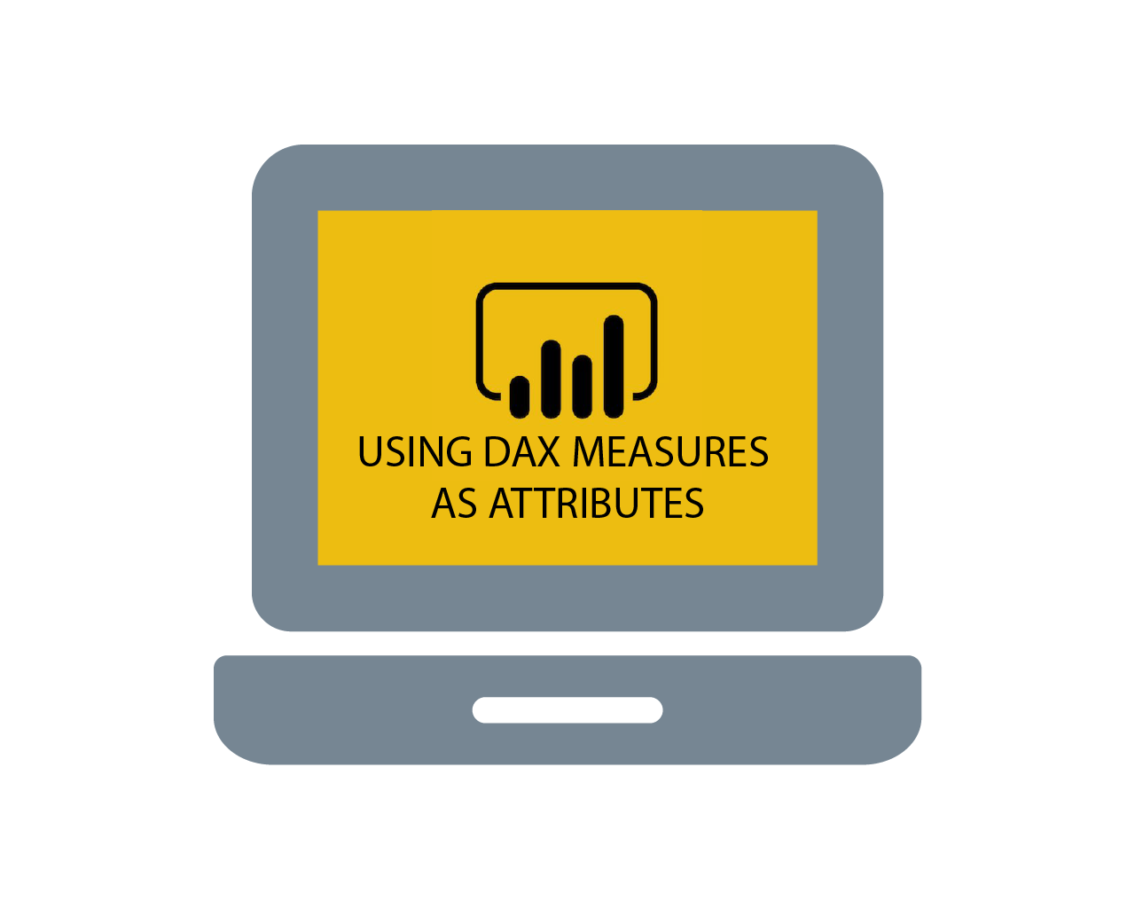
Data Processing and DAX Calculations
Aggregated metrics like total sales, average sales, average rating and count of items.
Used DAX to compute KPIs:
Total Sales = Total Sales = SUM('BlinkIT Grocery Data'[Sales])
Avg Sales = Average Sales = AVERAGE('BlinkIT Grocery Data'[Sales])
Items Sold = No of Items = COUNTROWS('BlinkIT Grocery Data')
Average Rating = Average Rating = AVERAGE('BlinkIT Grocery Data'[Rating])

Slide 8

Dashboard (Charts, Formatting)
Designed an interactive layout with:
KPI Cards for totals and averages.
Charts by outlet type, item type, fat content.
Filters and slicers for dynamic exploration.
Used bar, column, pie, bar and line visuals based on the metrics.
Used consistent color theme.

Slide 9

Reporting
Built report views for both high-level KPIs and detailed breakdowns.
Organized pages for:
Executive Summary
Sales Breakdown
Outlet Performance

Slide 10

Insights Generation
Identified high-performing outlet types and product segments.
Identified sales pattern based on increasing outlet establishment.
Noted correlation between fat content and sales volume.
Highlighted geographic sales trends and customer rating patterns.
Highlighted most consumed item types.

